Slide 1
Team presentation-4 NTCIR-15 Dialogue Evaluation Task
組員 : 黃彥鈞、黃顗亘、鄭宇雅、廖容毅

Slide 2
Outlines
Data Description
Approaches and Progress (single-label)
Approaches and Progress (multi-label)
Next steps

Slide 3
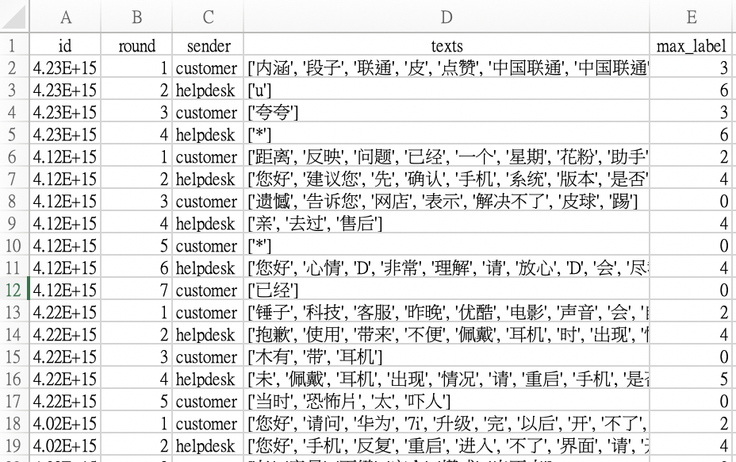
Data Description
該對話的第幾個輪次
19位標註者標註最多的標籤
Nugget Labels
CNUG0 | Customer trigger
CNUG* | Customer goal
HNUG* | Helpdesk goal
CNUG | Customer regular nugget
HNUG | Helpdesk regular nugget
CNaN | Customer Not-a-Nugget
HNaN | Helpdesk Not-a-Nugget

Slide 4
Approaches and Progress (single-label)
將texts(對話內容)加入模型中，以19位標註者標註最多的標籤作為label來預測
方法: (1.) ML: 利用 tfidf 特徵選取
(2.) DL: Neural network layer
BERT, LSTM, SVM, Logistic regression, Random Forest 效能較高
macro average
weighted average
 | precision | recall | F1-score | accuracy
BERT | 0.59 | 0.51 | 0.53 | 0.79
LSTM | 0.52 | 0.55 | 0.52 | 0.74
SVM | 0.58 | 0.45 | 0.47 | 0.80
LR | 0.66 | 0.45 | 0.46 | 0.80
RF | 0.51 | 0.47 | 0.46 | 0.78
 | precision | recall | F1-score | accuracy
BERT | 0.76 | 0.79 | 0.77 | 0.79
LSTM | 0.74 | 0.74 | 0.74 | 0.74
SVM | 0.76 | 0.80 | 0.76 | 0.80
LR | 0.77 | 0.80 | 0.76 | 0.80
RF | 0.75 | 0.78 | 0.76 | 0.78

Slide 5
Approaches and Progress (single-label)
將texts(對話內容)、round(輪次)、sender(發送人)加入模型中，以19位標註者標註最多的標籤作為label來預測
方法: (1.) ML: 利用 tfidf 特徵選取
(2.) DL: Neural network layer concatenation
LSTM, Random Forest, CNN 效能較高
 | precision | recall | F1-score | accuracy
LSTM | 0.54 | 0.55 | 0.54 | 0.86
Random Forest | 0.77 | 0.51 | 0.52 | 0.88
CNN | 0.52 | 0.52 | 0.52 | 0.86
macro
average
 | precision | recall | F1-score | accuracy
LSTM | 0.84 | 0.86 | 0.85 | 0.86
Random Forest | 0.86 | 0.88 | 0.84 | 0.88
CNN | 0.82 | 0.86 | 0.84 | 0.86
weighted
average

Slide 6
Approaches and Progress (single-label)
比較LSTM, Random Forest, CNN有無加入round(輪次)、sender(發送人)至模型中，performance的結果？
在各項指標(P/R/F1)中，performance 都有明顯提升
feature | model | precision | recall | F1-score | accuracy
texts | LSTM | 0.74 | 0.74 | 0.74 | 0.74
 | RF | 0.75 | 0.78 | 0.76 | 0.78
 | CNN | 0.67 | 0.72 | 0.68 | 0.72
texts, round, sender | LSTM | 0.84 | 0.86 | 0.85 | 0.86
 | RF | 0.86 | 0.88 | 0.84 | 0.88
 | CNN | 0.82 | 0.86 | 0.84 | 0.86
weighted
average

Slide 7
Approaches and Progress (multi-label)
Multi-label: 共有7個label，將每個label分開訓練模型，分別找出效能最佳的作為預測
為什麼需要做 multi-label?
(1.) 因為有19位標註者，而每一位標註的結果都同樣的重要
(2.) 資料分布不平均
multi-label 如何進行機器學習?
Problem Transformation Method
Algorithm Independent
Instance-based Transformation

Slide 8
Approaches and Progress (multi-label)
10-fold
Label 重新編碼：0:CNUG, 1:CNUG *, 2:CNUG0, 3:CNaN, 4:HNUG, 5:HNUG *, 6:HNaN
 | model | precision | recall | F1-score | accuracy
Label 0 | LR | 0.9987 | 0.8317 | 0.9345 | 0.9359
Label 1 | LR | 0.8429 | 0.2814 | 0.9172 | 0.9330
Label 2 | SVM | 0.9475 | 0.7868 | 0.9161 | 0.9184
Label 3 | NB | 0.9997 | 1 | 0.9998 | 0.9998
Label 4 | NB | 0.9999 | 1 | 0.9999 | 0.9999
Label 5 | LR | 0.8059 | 0.9502 | 0.9117 | 0.9101
Label 6 | NB | 0.9996 | 1 | 0.9998 | 0.9998

Slide 9
NEXT STEPS
計算multi-label合併後數列的相似度 (利用JSD)
嘗試更多 data representation 的方法
嘗試 sequence_based method，將每組對話前面的輪次(round)資訊納入模型考量

Slide 10
Thanks for listening!

